Slide 1
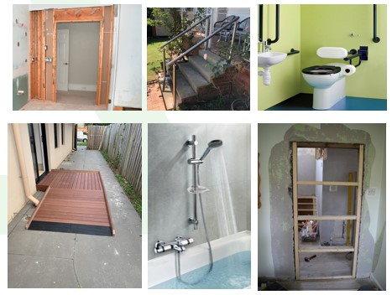
Minor Home Modifications
Level 1 – Basic Modifications
Simple and straightforward changes that can be easily implemented and address basic accessibility needs. This may include the installation of grab rails, handrails, or lever door handles and taps and magnetic door catches, etc..
NDIS Participants may use core funding to obtain level 1 minor modifications.
Level 2 – Standard Modifications
These encompass a broader range of changes and are slightly more complex than Level 1. They may involve alterations to the physical environment to improve accessibility, such as widening doorways to accommodate wheelchairs, installing ramps, or mixer taps, closing a door opening, etc.
They require planning and coordination to ensure they meet the specific needs of the individual while adhering to building codes and regulations.
NDIS Participants may use core or capital funding to obtain level 2 minor modification.
This presentation prepared by National Disability Building Services - www.ndbs.net.au

Slide 2
NDIS Funded Complex Home Modifications
Stage 1 - Assessment and Planning
Stage 2 - Design and Documentation
Stage 3 - Approvals and Funding
Stage 4 - Construction and Installation
Stage 5 - Completion and Evaluation
All photos used to the following slides are courtesy of Getty Images

Slide 3
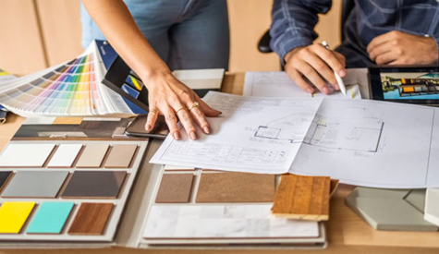
Complex Home Modifications Stage 1- Assessment and Planning
Occupational therapists (OTs) and relevant professionals conduct assessments to understand the individual's mobility, accessibility challenges, and daily living activities.
Based on the assessment, building project manager and OT develop concept/design floor plans for areas that need modification. This stage ensures a comprehensive understanding of the individual's needs, guiding the development of tailored modifications that promote safety, accessibility, and independence within their own home.

Slide 4
Complex Home Modifications Stage 2 - Design and Documentation
This stage involves creating floor plans, architectural drawings, and specifications to guide the construction process.
This documentation ensures that the modifications are accurately communicated to contractors and stakeholders, enabling a smooth implementation of the planned modifications.

Slide 5
Complex Home Modifications Stage 3 - Approvals and Funding
This stage involves:-
Obtaining permits, complying with local regulations, and seeking any required permissions;
Applying for funding through NDIS or exploring other funding options available through government programs & initiatives.
It is crucial to navigate the administrative processes efficiently to ensure the necessary and timely financial support for the project.

Slide 6
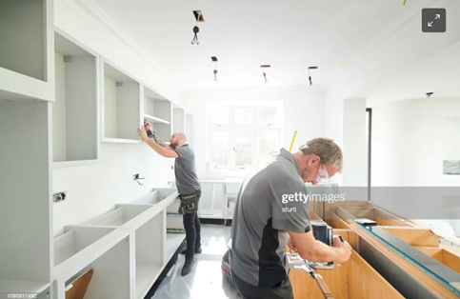
Complex Home Modifications Stage 4 - Construction and Installation
This stage begins with the tendering process, where qualified contractors are invited to submit their bids for the home modification project.
The project manager awards the contract to a skilled & qualified builder to perform the work in accordance with the approved designs and specifications and the terms of the contract. Close supervision by the project manager, quality control, and adherence to timelines ensure a successful construction and installation process.

Slide 7
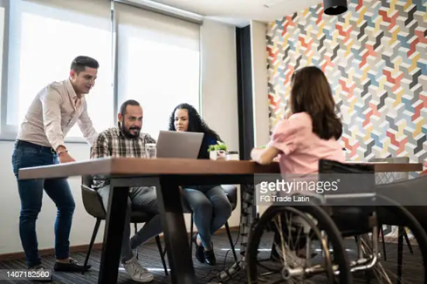
Complex Home Modifications Stage 5 - Completion and Evaluation
In this stage, the home modifications are finalised, and their effectiveness is assessed. The individual, along with relevant professionals, evaluates the functionality and usability of the modifications. Any necessary adjustments or fine-tuning are made to ensure optimal outcomes.
This stage also involves documentation and ‘closing out’ the project, including finalising any remaining administrative tasks and ensuring that all stakeholders are satisfied with the completed modifications.

